Slide 1
Software Engineering SEN-220
Architectural Design
Mobeen Nazar
Lecturer
Software Engineering Department

Slide 2
Chapter-09: Architectural Design
Objectives
  Architectural Design
  ADL(Architectural description language )
  Summary

Slide 3
Why Architecture?
The architecture is not the operational software. Rather, it is a representation that enables a software engineer to:
(1) analyze the effectiveness of the design in meeting its stated requirements,
(2) consider architectural alternatives at a stage when making design changes is still relatively easy, and
(3) reduce the risks associated with the construction of the software.

Slide 4
Why is Architecture Important?
Representations of software architecture are an enabler for communication between all parties (stakeholders) interested in the development of a computer-based system.
The architecture highlights early design decisions that will have a profound impact on all software engineering work that follows and, as important, on the ultimate success of the system as an operational entity.
Architecture “constitutes a relatively small, intellectually graspable mode of how the system is structured and how its components work together”

Slide 5
Architectural Description
An architectural description is sometimes referred to as a structural description. In general, a structural description does not describe the functionality of the circuit, but it may include information about actual or estimated performance.

Slide 6
Architectural Styles
Each style describes a system category that encompasses:
a set of components (e.g., a database, computational modules) that perform a function required by a system,
a set of connectors that enable “communication, coordination and cooperation” among components,
constraints that define how components can be integrated to form the system, and
semantic models that enable a designer to understand the overall properties of a system by analyzing the known properties of its constituent parts.
Data-centered architectures
Data flow architectures
Call and return architectures
Object-oriented architectures
Layered architectures

Slide 7
Data-Centered Architecture
A data store will reside at the center of this architecture and is accessed frequently by the other components that update, add, delete or modify the data present within the store.
This data-centered architecture will promote integrability. This means that the existing components can be changed and new client components can be added to the architecture without the permission or concern of other clients.

Slide 8
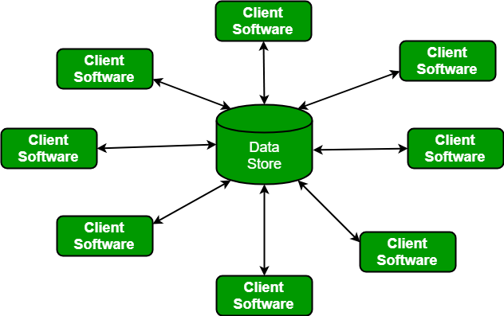
Data-Centered Architecture

Slide 9
Data flow architecture
This kind of architecture is used when input data to be transformed into output data through a series of computational manipulative components.
The figure represents pipe-and-filter architecture since it uses both pipe and filter and it has a set of components called filters connected by pipes. Pipes are used to transmit data from one component to the next.
Each filter will work independently and is designed to
take data input of a certain form and produces data output to the next filter of a specified form.

Slide 10
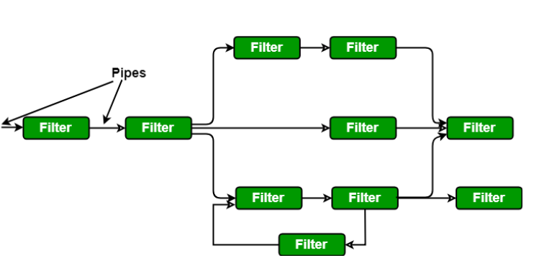
Data Flow Architecture

Slide 11
Call and Return Architecture
It is used to create a program that is easy to scale and modify. Many sub-styles exist within this category. Two of them are explained below.
Remote procedure call architecture: This components is used to present in a main program or sub program architecture distributed among multiple computers on a network.
Main program or Subprogram architectures: The main program structure decomposes into number of subprograms or function into a control hierarchy. Main program contains number of subprograms that can invoke other components.

Slide 12
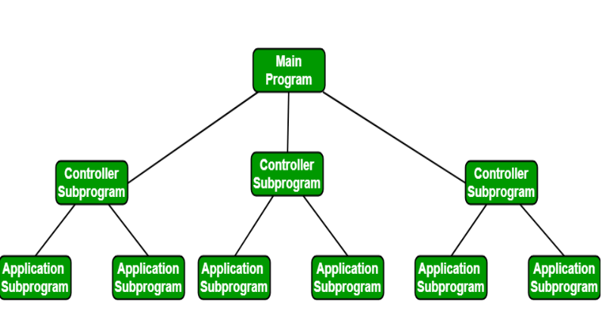
Call and Return Architecture

Slide 13
Layered Architecture
A number of different layers are defined with each layer performing a well-defined set of operations. Each layer will do some operations that becomes closer to machine instruction set progressively.
At the outer layer, components will receive the user interface operations and at the inner layers, components will perform the operating system
interfacing(communication and coordination with OS)
Intermediate layers to utility services and application software functions.

Slide 14
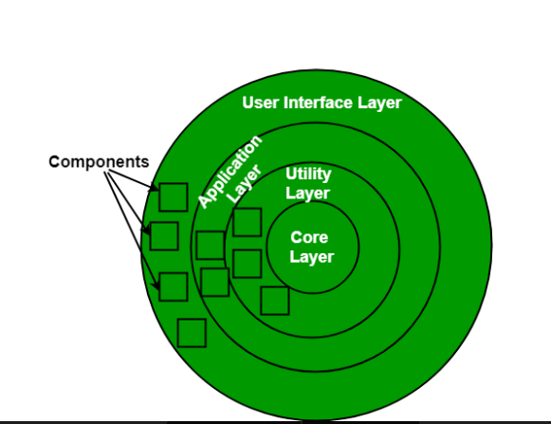
Layered Architecture

Slide 15
Architectural Complexity
the overall complexity of a proposed architecture is assessed by considering the dependencies between components within the architecture.
  Sharing dependencies represent dependence relationships among consumers who use the same resource or producers who produce for the same consumers.
  Flow dependencies represent dependence relationships between producers and consumers of resources.
  Constrained dependencies represent constraints on the relative flow of control among a set of activities.

Slide 16
ADL
Architectural description language (ADL) provides a semantics and syntax for describing a software architecture
Provide the designer with the ability to:
  decompose architectural components
  compose individual components into larger architectural blocks and
  represent interfaces (connection mechanisms) between components.

Slide 17
Partitioning the Architecture
“horizontal” and “vertical” partitioning are required

Slide 18
Why Partitioned Architecture?
results in software that is easier to test
leads to software that is easier to maintain
results in transmission of fewer side effects
results in software that is easier to extend

Slide 19
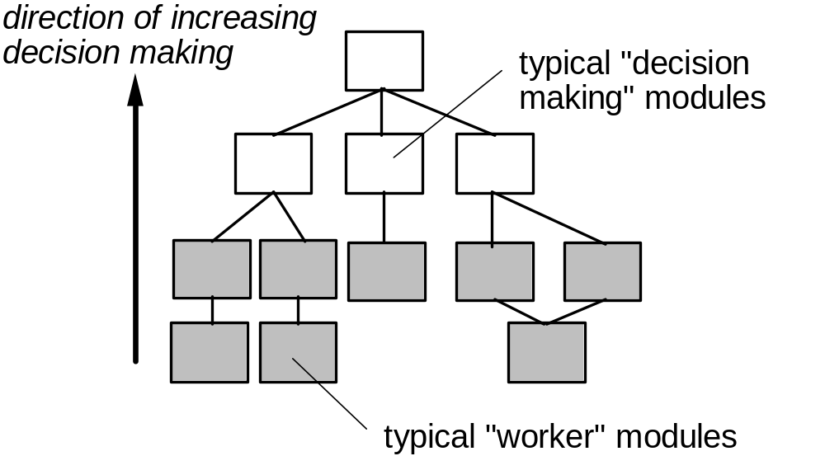
Factoring

Slide 20
Summary
This lecture emphasise on Architectural design of a software.
Various techniques have been discussed to analyse and design the architecture of the system that is to be developed.
Partitioning is the significant part of Architectural Design.

Slide 21
References
1- These slides are designed to accompany Software Engineering: A Practitioner’s Approach, 7/e (McGraw-Hill 2009). Slides copyright 2009 by Roger Pressman.
2- http://www.cs.unc.edu/~stotts/145/cocomo7.gif

